Slide 1
2026 – Summer Internship Project
LM RMS TLS Orlando
Monday, February 23rd, 2026
Chase Burchett, Hardware Engineer Stf

Slide 2


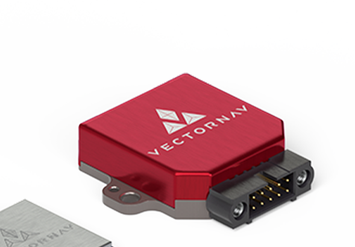



2026 Intern Project – TLS (Training, Logistics, Simulation)
PROBLEM STATEMENT: Bad actors worldwide are leveraging low-cost commercially available drone technology to improvise aerial weapons in large quantities. Attacks from these weaponized unmanned aerial systems (UAS) have been dangerously effective and difficult to defend against. According to the Department of War, these attacks have “fundamentally and irrevocably changed” the military operational landscape. Accordingly, Lockheed Martin Training Logistics and Simulation (TLS) has tasked its 2026 summer interns to develop a low-fidelity counter UAS (cUAS) training system called the “Swarm Defense Trainer”, or the SDT.
SUBJECT MATTER EXPERT:
Chase Burchett – Hardware Engineer Stf
SCOPE: 8-week execution from June 8th kickoff to July 30th demonstration
The 2026 Summer Interns will be divided into two interdisciplinary teams
Software Development: Interns will develop a simple training game in Unreal Engine 5
Hardware Development: Interns will design, fabricate, and assemble a physical training device
System Integration: Interns will integrate the hardware with the training game software
Gameplay: Interns & stakeholders will test the trainer, documenting a list of future improvement ideas

Slide 3
TLS 2026 SOW Recap
2026 Intern Project: Swarm Defense Trainer (SDT)
Scope / Background: (Simplified)
Teams are to design, build, integrate, and demonstrate a first-person shooter style simulation game which will train soldiers to defend high-value assets against drone swarm attacks
Background: A new “Swarm Defense Trainer” must be developed in response to the rise in attacks from improvised aerial weapons.
Deliverables:
A working Swarm Defense Trainer (SDT)
An integrated hardware and software product
Product Presentation (PowerPoint)
Tech Roadmap (PowerPoint)
Assumptions/Constraints:
A VectorNAV VN-100 device will be provided to each team
Each team will have multiple interns with Tier 3 LM laptops
Goal: 1/3 of the interns on each team receive a Tier 3 laptop
Each Tier 3 Laptop will have Unreal Engine 5 installed
Stakeholders will be available to provide input for the duration of the project.
Stakeholders will meet with teams on a periodic basis to check progress.
Teams will engage with stakeholders early and throughout the project to ensure that their needs are understood and addressed.
The project will need to be completed by July 28th, 2026.
Requirements: (Most of the Functional)
The SDT shall consist of custom hardware & software
The SDT gameplay shall be first-person shooter style
The game shall be single player
Gameplay shall last for at least 30 seconds
The user shall defeat (shoot) incoming autonomous vehicles
Game shall have Scoring System
The game shall keep a Top-10 score board
Game shall include hand-held hardware
The VN-100 device shall be mounted to the hand-held hardware
The aim of the weapon in the game shall be controlled by the orientation of the VN-100 via a custom plug-in for Unreal Engine
The game shall have sound effects

Slide 4
Trainer Selection Criteria
Working product
Agile Principle #7 / 12
Immersion
Look of map
Sound effects
Feel of hardware
Reliability
Software: bug-free game play
Hardware: quality, durability
Product Presentation
Compelling features
Engaging format
Tech Roadmap
Customer-centric vision
Viable
Category | Weight | Team 1 | Team 2
Tech Maturity (Working Product) | x 2.0
Immersion (Customer Experience) | x 1.5
Reliability & Quality | x 1.5
Product Presentation | x 1.2
Tech Roadmap | x 1.0
TOTAL Score:

